Slide 1
Zomato’s Recipe for Global Expansion: A Taste of Success
Name: Arpita Saha
13/3/2024

Slide 2

Introduction
Explore Zomato’s recipe for global expansion and key ingredients for success in the international market.
Zomato started as a local restaurant discovery platform in India and expanded globally.
Their journey reflects the evolution of the food industry and the power of digital platforms.
Zomato’s success lies in thorough market analysis and understanding of local cuisines and consumer preferences in each market.
Ability to adapt to local cultures and cuisines has been a key factor in Zomato’s global expansion strategy.
This adaptability allows Zomato to connect with a diverse range of customers.

Slide 3
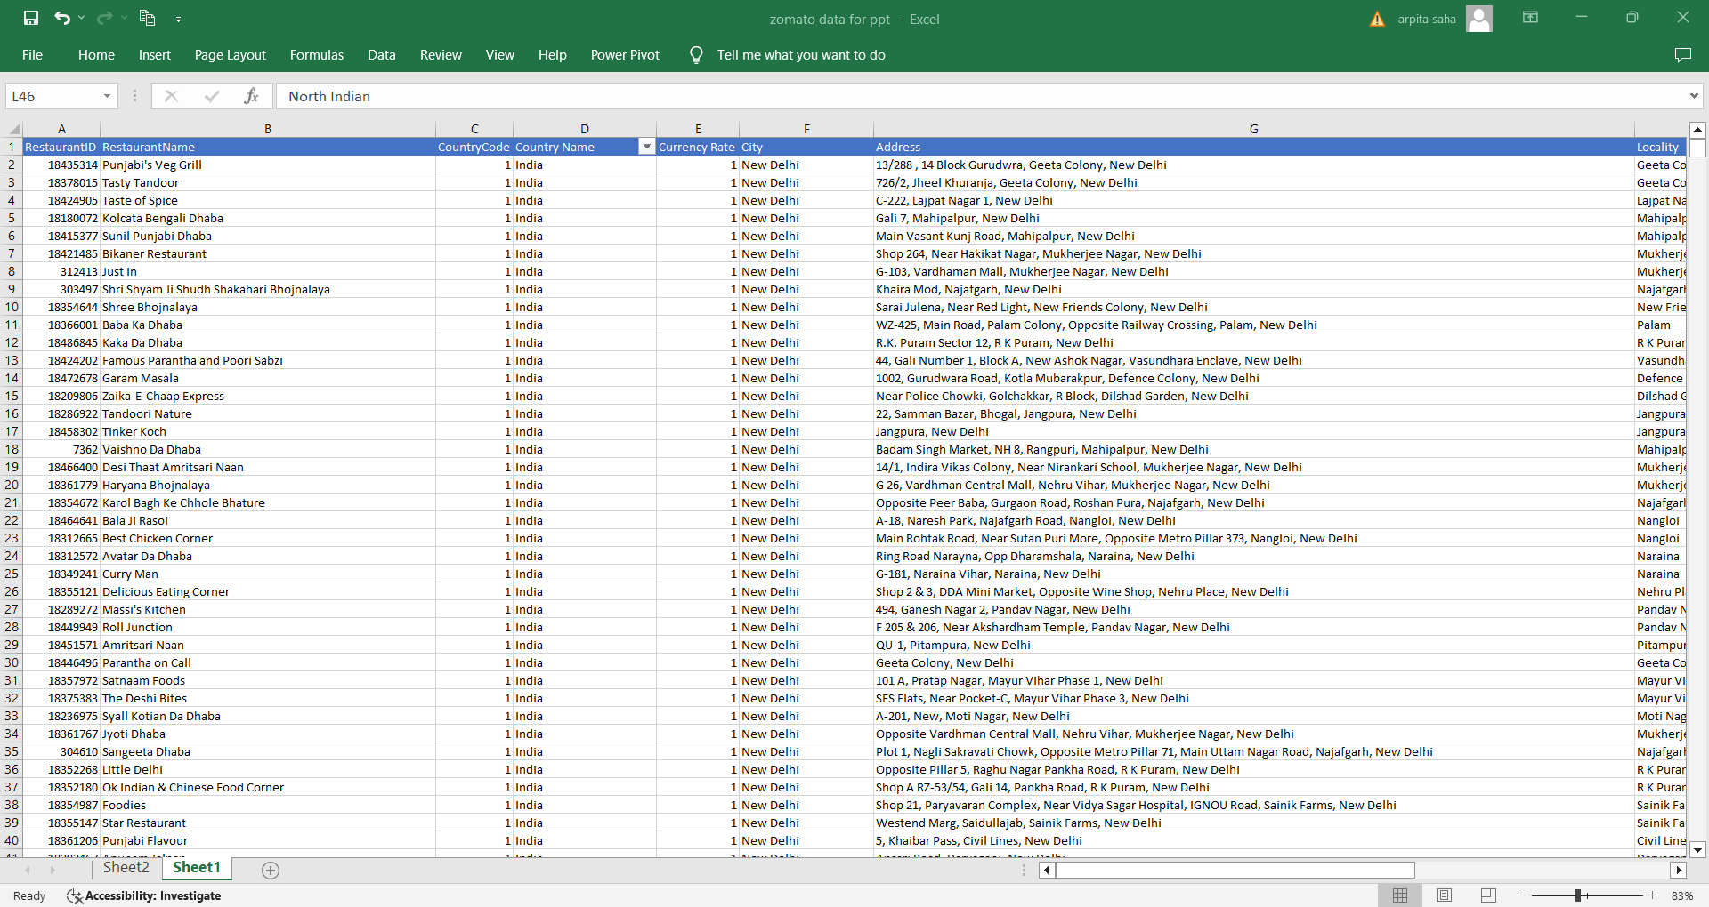
Problem Statement
I am hired as a consultant data analyst by Zomato where the team is looking for expansion and opening restaurants. My task is to come up with strategies/suggestions about opening newer restaurants.

Slide 4

Data snapshot
RestaurantID
RestaurantName
CountryCode
Country Name
Currency Rate
City
Address
Locality
LocalityVerbose
Longitude
Latitude
Cuisines
Currency
Abbreviation
Has_Table_booking
Has_Online_delivery
Is_delivering_now
Switch_to_order_menu
Price_range
Votes
Array Formula
Average_Cost_for_two
Average_cost fro two with currency symbol
Avg Cost of Two in Rs.
Rating
Datekey_Opening
year
Month
KPIS
RestaurantName
Country Name
Price_range
Votes
Rating
Datekey_Opening
Available Data

Slide 5

Analytical Approach and Tools
Enhanced the dataset with additional variables using VLOOKUP to
cross reference external data sources.
Employed pivot tables and summarizing key metrics to
identify how we can open new restaurants in different countries or cities
Created dynamic charts and dashboards for data representation, enabling
interactive data exploration.
Figured out KPIs from the available data like
Country name, Price_range, Voting, Rating, Year of opening.

Slide 6
As we can see from the chart, we can open new restaurants in the countries where the number of restaurants are less and also known for their tourist business. Like Canada, Australia, Qatar, Singapore & Philippines.

Slide 7
Canada has the highest number of votes, suggesting strong interest or favorable conditions for restaurant expansion.
Higher votes indicate higher market potential and interest in new restaurant ventures.
Strategies for expansion might differ based on the interest levels. For instance, in Australia, aggressive marketing and larger investments might be justified, while in Qatar, a more cautious approach might be warranted.

Slide 8
In Canada and Qatar, where ratings are highest, focus on maintaining quality and leveraging positive customer feedback.
In Singapore, ensure consistent quality and consider marketing strategies to enhance visibility.
In Australia investigate the reasons for lower ratings and address any identified issues to improve customer satisfaction.
Understand cultural preferences, dining habits, and economic conditions in each country to tailor your restaurant offerings and marketing strategies.

Slide 9
• Dominant Cuisine: American cuisine, including variants like Tex-Mex, Mexican, and Steak, appears frequently on the chart. This suggests a strong preference for American flavors across the recommended countries.
• Italian Cuisine: Italian cuisine is prominently featured, indicating its widespread popularity.
• Western and Fusion: Western, Fusion, and Fast Food are also highly recommended, showcasing a trend towards mixed and contemporary food styles.
• European Influence: There is a significant presence of European-based cuisines like French, Mediterranean, and broader European categories, highlighting the influence of European culinary traditions.
• Street Food: The inclusion of street food, particularly Indian, points to a growing interest in more casual and authentic dining experiences.
• Café Culture: The mention of cafes alongside other cuisines indicates a cultural preference for casual dining environments that offer a variety of food options.

Slide 10

City Recommendation in Australia
As per the chart we can say that in Palm Cove, Philip Island, Tanunda, and Beechworth Zomato can open Restaurants. And all the places are Tourist Spot, so the business will do well

Slide 11

City Recommendation in Canada
As per the chart we can say that Zomato can open Restaurants in Vineland Station and Chatham-Kent. Vineland is known for its orchards, vineyards, wineries and Restaurants that feature local produce and wines.

Slide 12

City Recommendation in Qatar
Doha is the Capital city and main financial hub of Qatar. Doha is known for its modern architecture, high rise buildings and Luxurious shopping malls. So this place is good for opening new Restaurants.

Slide 13

City Recommendation in Singapore
Singapore is an Island Country mainly known for its Tourism business. Its known for its generally stable political and business climate. There sis something for everyone in the Lion City.

Slide 14

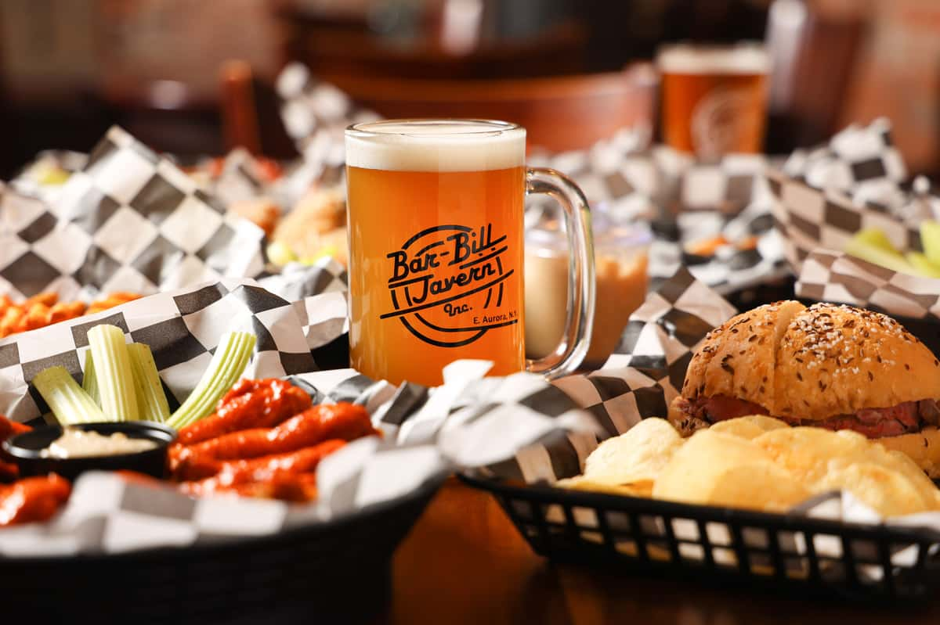
Suggestions of Cuisines in the Recommended Cities of Australia
As we can see in the Chart Mediterranean, Seafood ,Bar food, and Pizza will be the recommended Cuisine

Slide 15
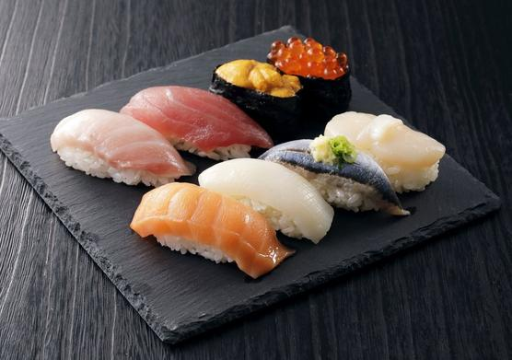
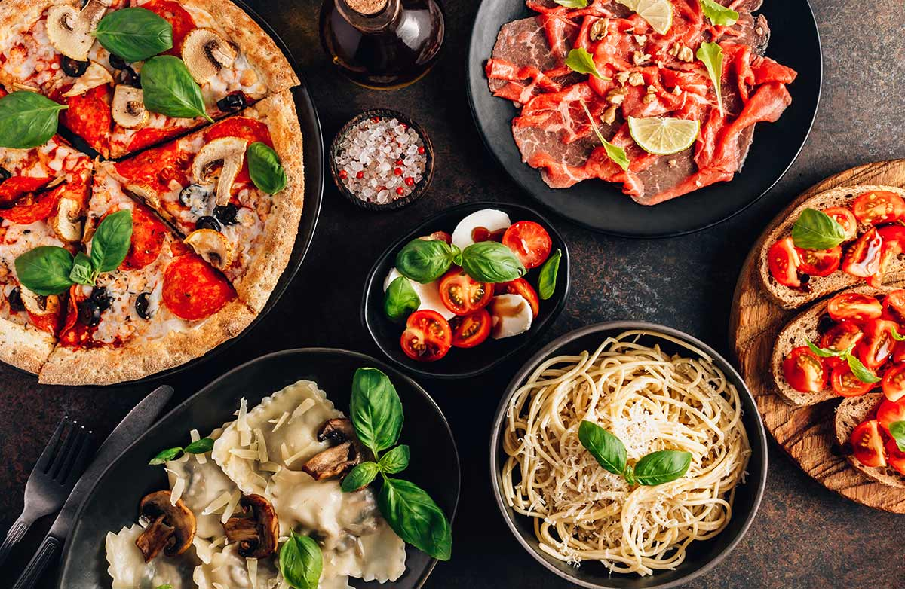
Suggestion of Cuisines in Recommended Cities of Canada

Slide 16
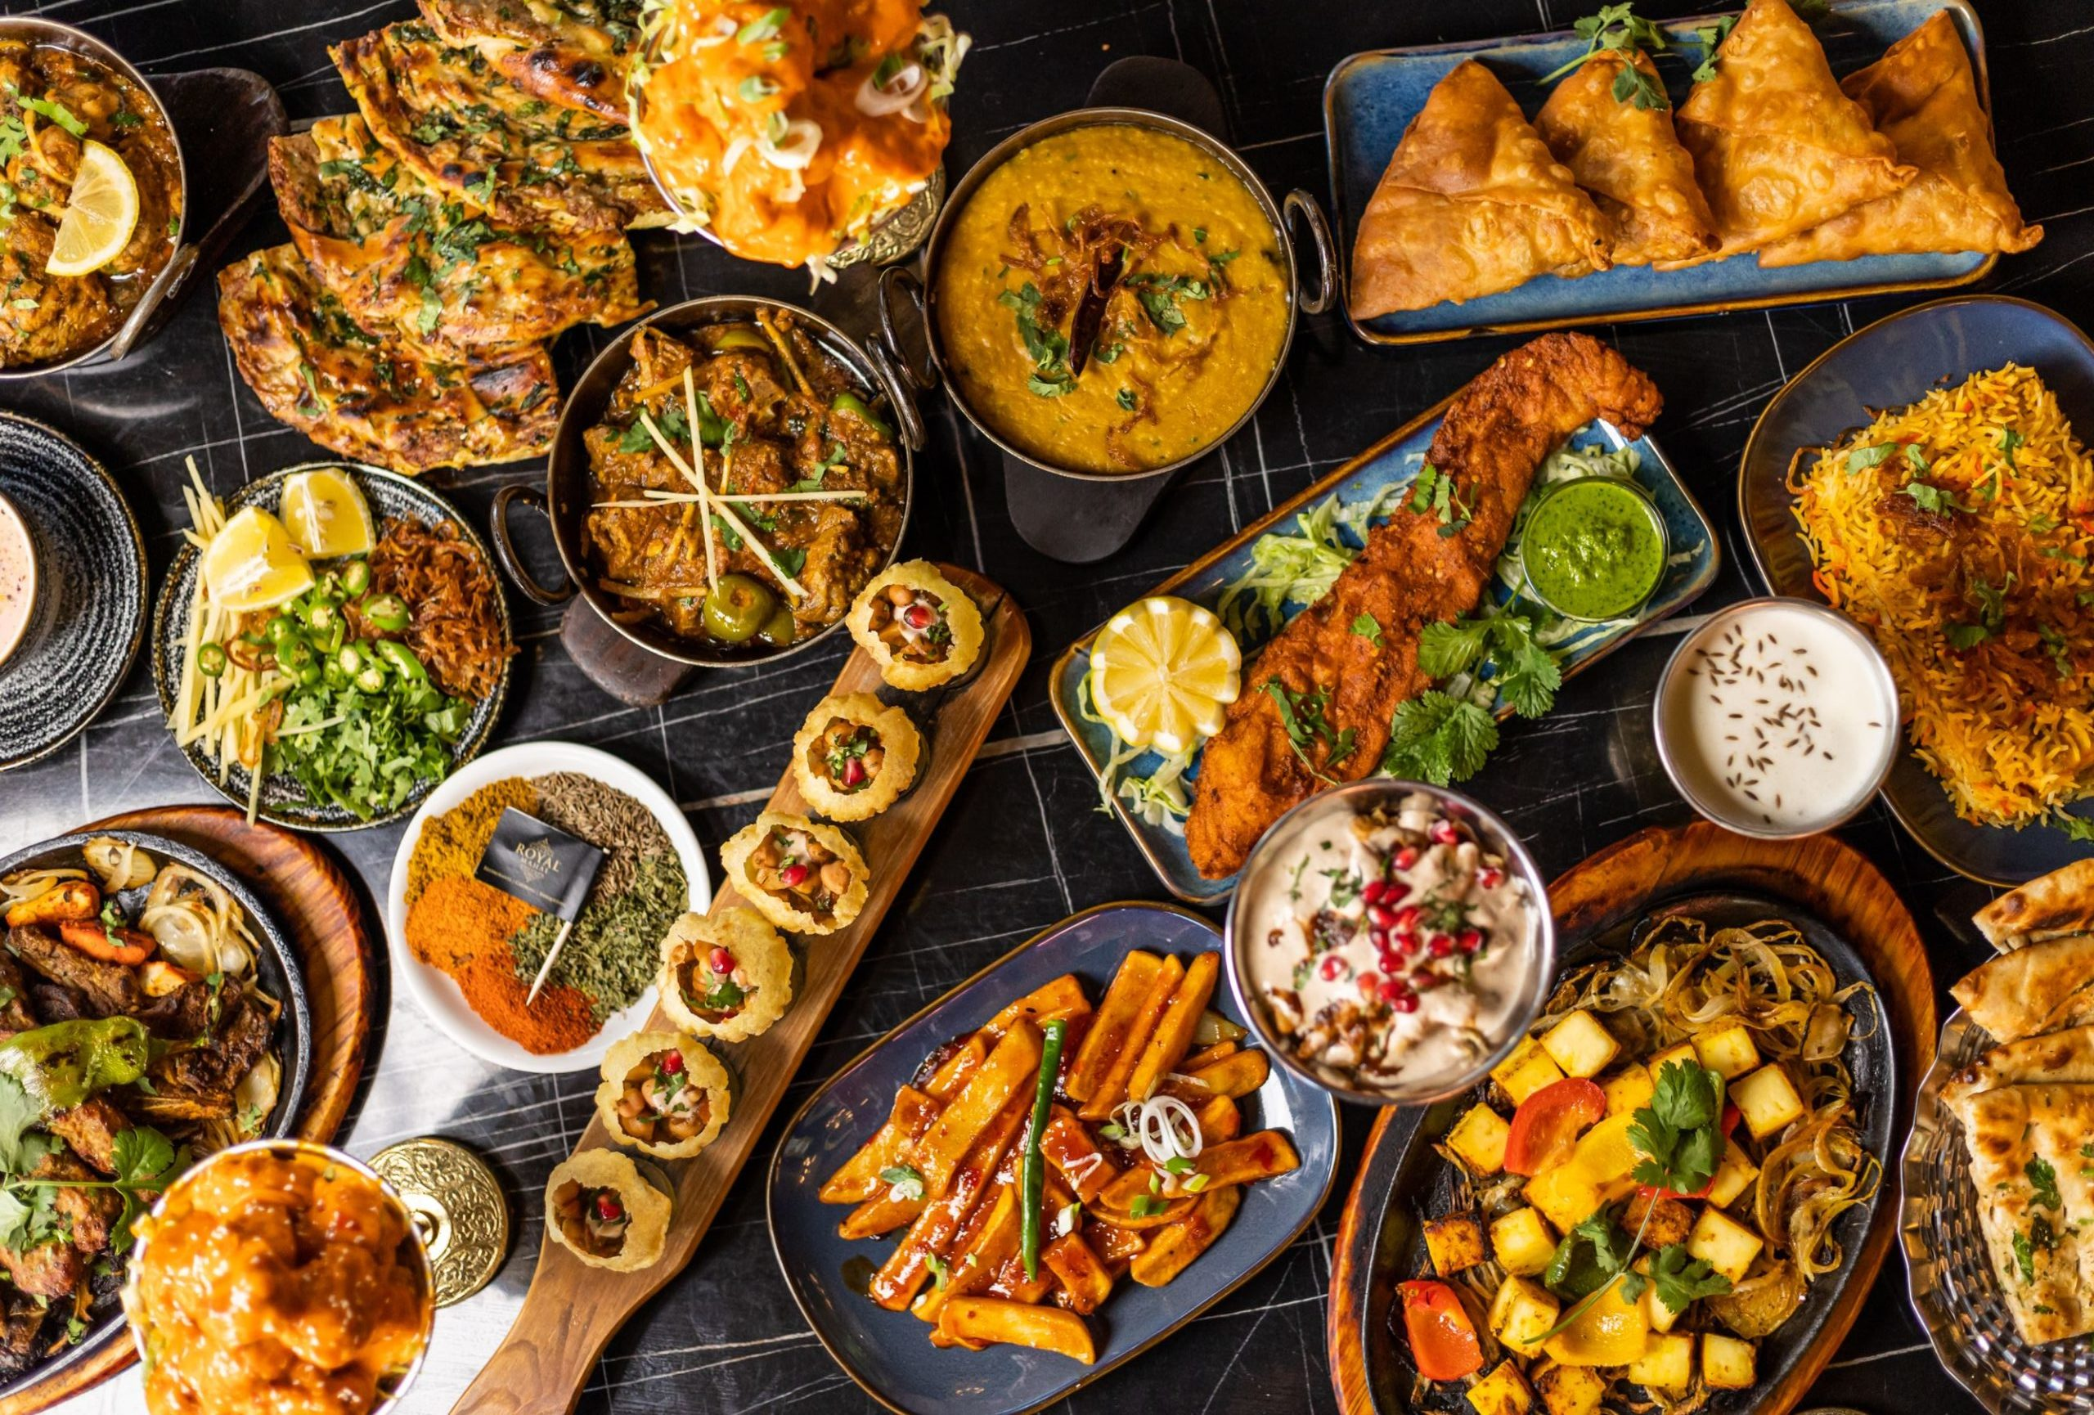
Suggestion of Cuisines In Doha
As we can see in the chart, Arabian, Indian, Pakistani, Chinese, Thai Food will be the best food recommendation for opening a new Restaurant.

Slide 17
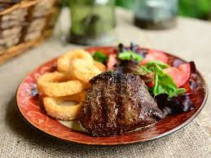

Suggestion of Cuisines in Singapore
As Singapore is a Tourist spot so any kind of food can be recommended .

Slide 18
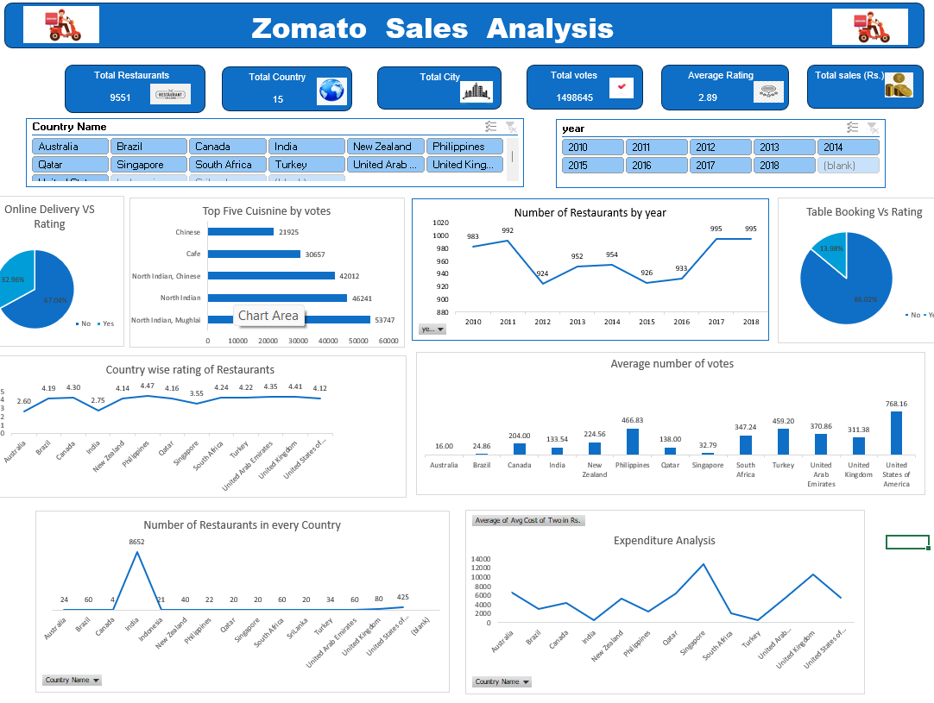

Slide 19
Summary
Checked Major KPIs to measure Zomato’s performance countries
Given details about data cleaning steps
Shortlisted 4 countries
Explained the details about the suggested countries on the basis of avg votes and ratings
Shortlisted cities in the suggested countries and suggested cuisines on basis of ratings

Slide 20
Acknowledgement
I Acknowledge my mentor for this project for giving me insights about how we can use Excel to analyze. Also I would like to thank Newton School for providing me this platform to learn and improve my skills. Along with that my batchmates and the TA sessions also helped me in many ways to bring this PPT on the table

